Slide 1



06-Starter-Sales Analysis Report 3
View in Power BI
Last data refresh:
9/28/2024 10:24:42 PM UTC
Downloaded at:
9/28/2024 11:18:36 PM UTC

Slide 2
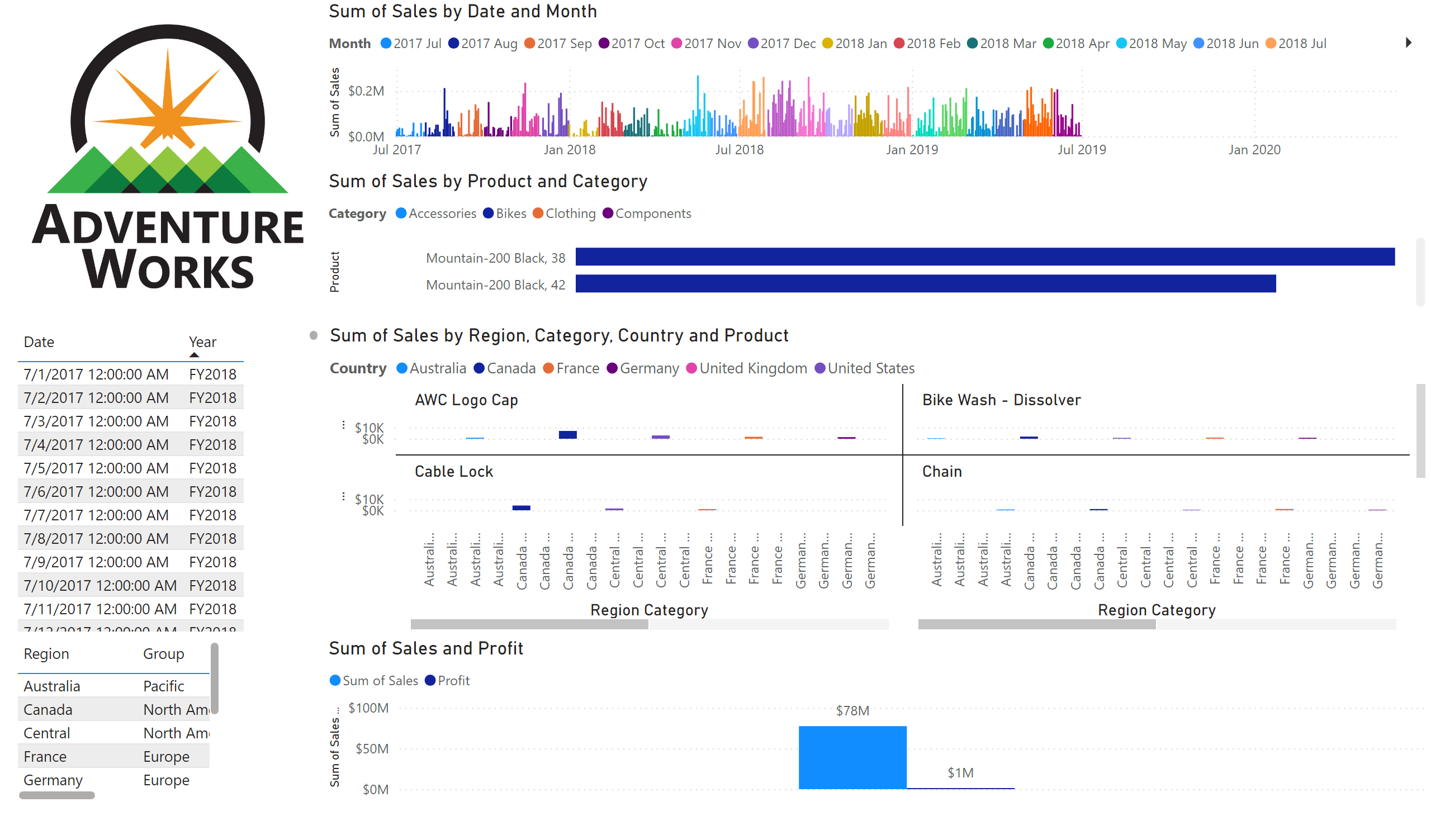
Overview
Notes:
image
No alt text provided
tableEx
No alt text provided
tableEx
No alt text provided
lineStackedColumnComboChart
No alt text provided
clusteredColumnChart
No alt text provided
columnChart
No alt text provided
barChart
No alt text provided

Slide 3
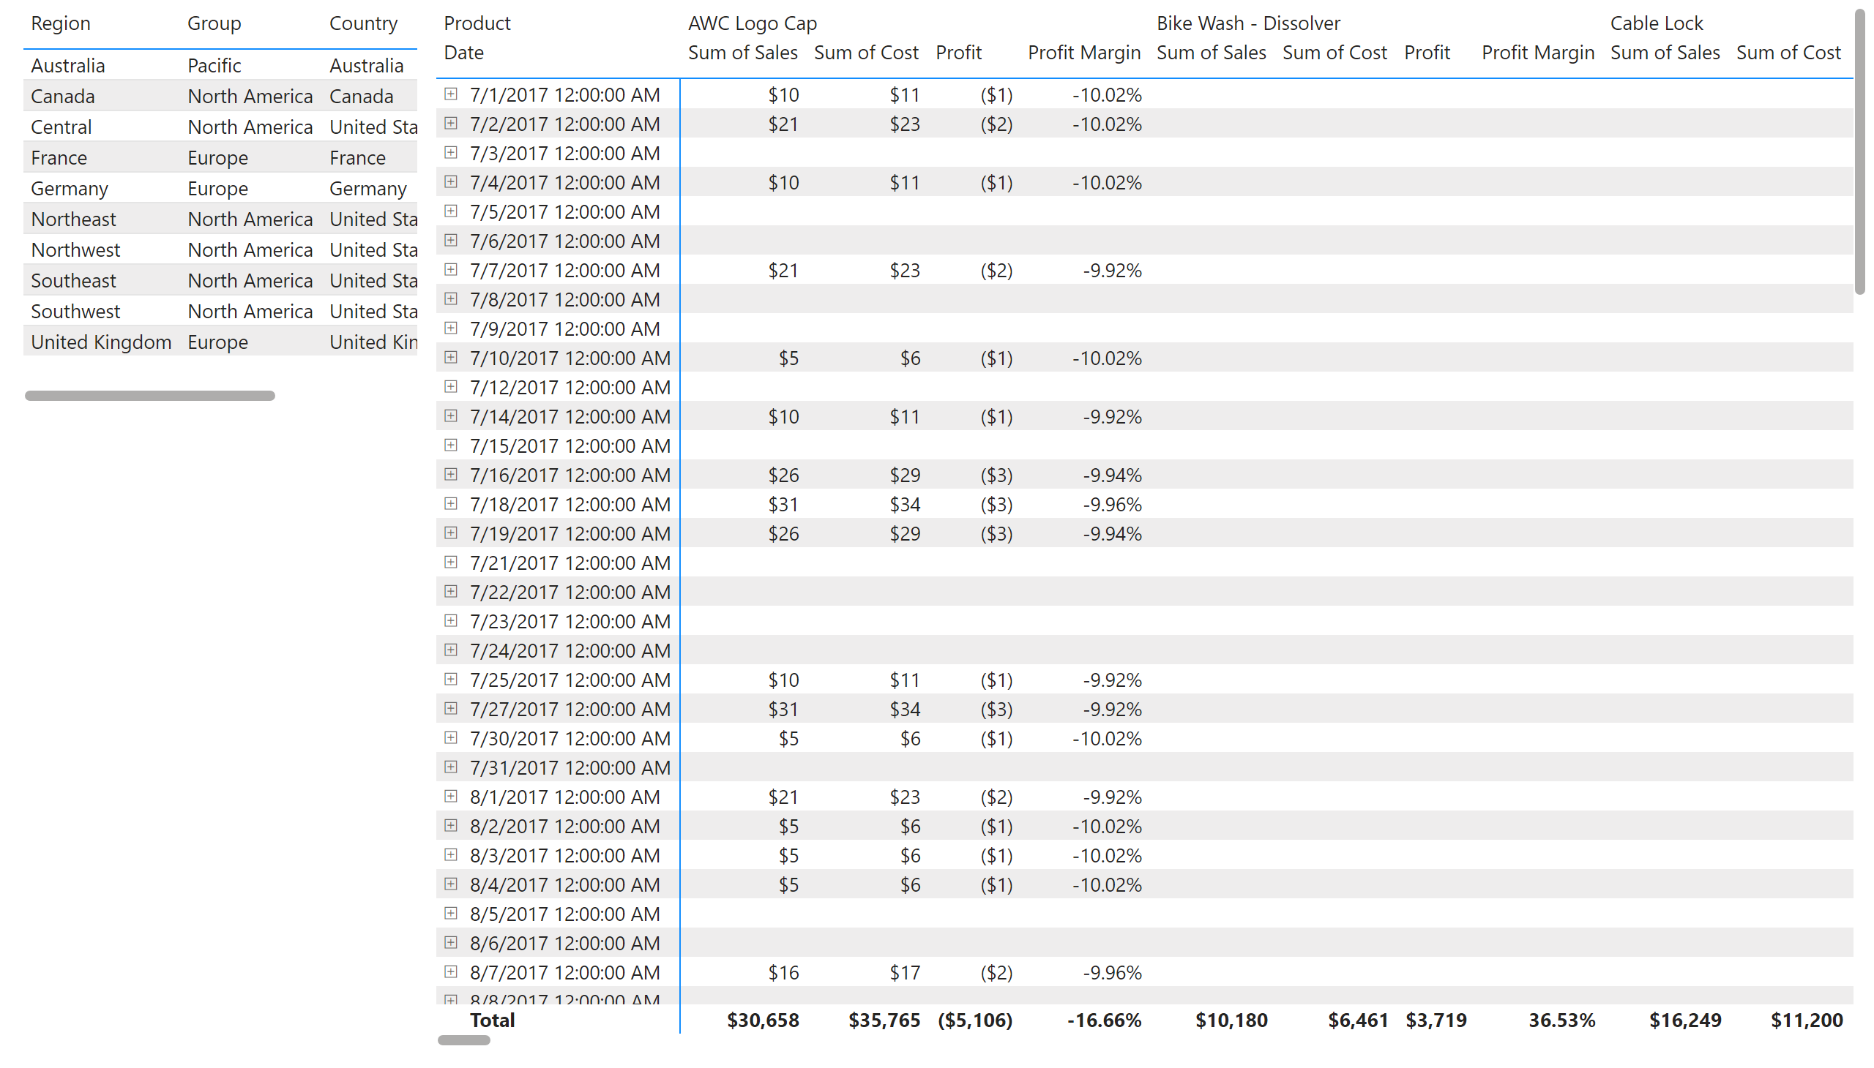
Profit
Notes:
tableEx
No alt text provided
pivotTable
No alt text provided

Slide 4
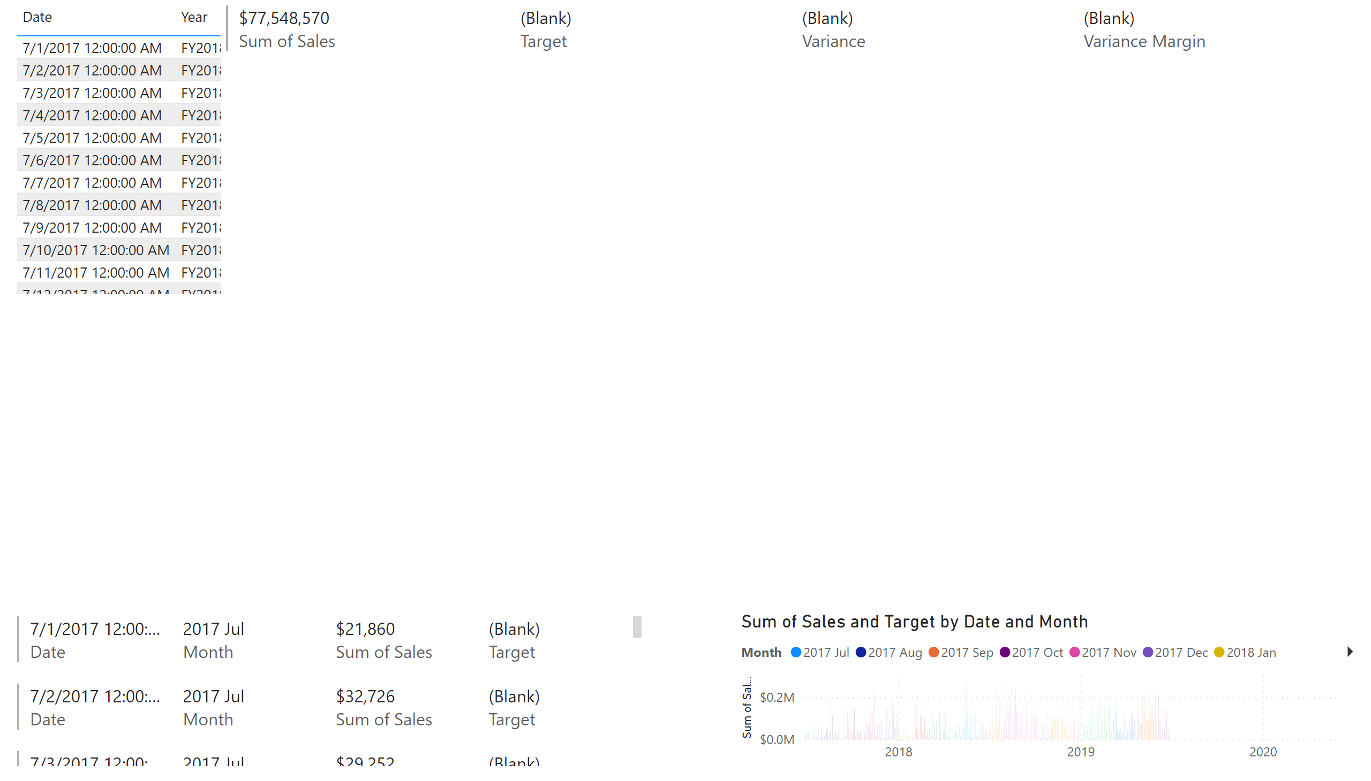
My Performance
Notes:
tableEx
No alt text provided
multiRowCard
No alt text provided
textbox
No alt text provided
multiRowCard
No alt text provided
clusteredColumnChart
No alt text provided

